Slide 1

The Dark Sector of the Universe and the BINGO/ABDUS project.
I present the observational and theoretical developments concerning the cosmological structure since the Discovery of a Dark Sector comprising the overwhelming majority of cosmological matter constituents.
I especially argue in favour of the construction of the BINGO (BAO from Integrated Neutral Gas Observations) observatory, which is being supported by a consortium led by Brazil and China and its second phase, with high resolution, the ABDUS Project, Advanced Bingo Dark Universe Studies.
Elcio Abdalla
João Pessoa 2024

Slide 2
Team
Management: Elcio Abdalla, A. Queiroz, Bin Wang, F. Abdalla and others
Builders: JiaJun Zhang, Chang Feng, Ricardo Landim, Alessandro Marins, João Rafael, Edmar Gurjão
Members (USP): Jordany Vieira de Melo, Pablo Motta, Gabriel Hoerning, Eveling Costa and others.
Other members: UFCG, INPE and others (Brazil), China (many Universities and companies), France, UK, Italy.
Total: more than 80 members

Slide 3
Support
FAPESP
Paraiba Government
FINEP
MCTI
Chinese Government
Others

Slide 4
Open Problems in the study of the cosmos
What is Dark Energy
What is Dark Matter
Gravity in Cosmology
Fast Radio Bursts
Pulsars

Slide 5
The Dark Matter Question: brief history
Speculations about Dark, unknown Matter exist since XIX century (see wikipedia)
Observations by Oort in 20´s point to excess of Matter, however not really established until further observations Much later by himself and Babcock.
The first real indication came with Zwicky, 1933, observing the Coma Cluster. In spite of the wrong used value of the Hubble constant this was the first real indication of Dark Matter
Further observations of Galaxy rotation curves little by little confirm the Dark Matter existence

Slide 6
The Dark Matter Question: establishing facts
Further observations in Green Bank and Jodrel Bank in the 70´s
Large Scale structure observations.
CMB observations (more later).
Today: Further observations from lensing, cosmological parameters fixing via precision observations
Distant Supernovae (more about that for Dark Energy)
Redshift Space Distortion
Baryon Acoustic Oscillations

Slide 7
The Dark Matter Question: conclusion
Dark Matter is a reality
It roughly corresponds to 27% of the energy budget of the Universe.
Interaction with visible matter is either inexistente (except for gravity) or very weak

Slide 8
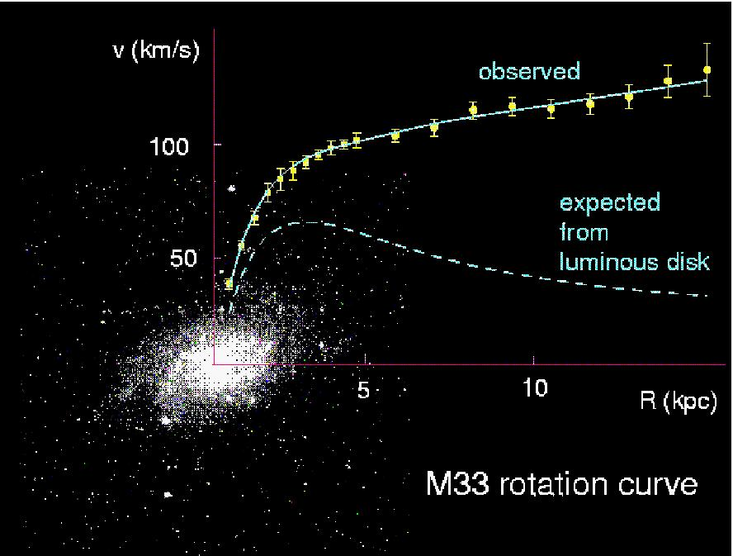
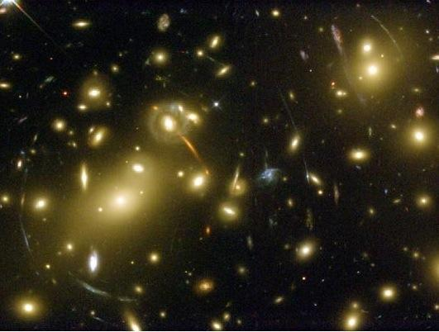
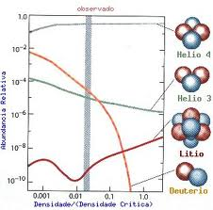
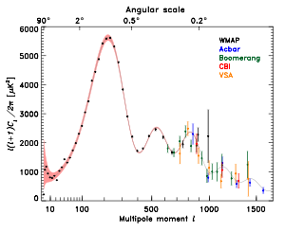
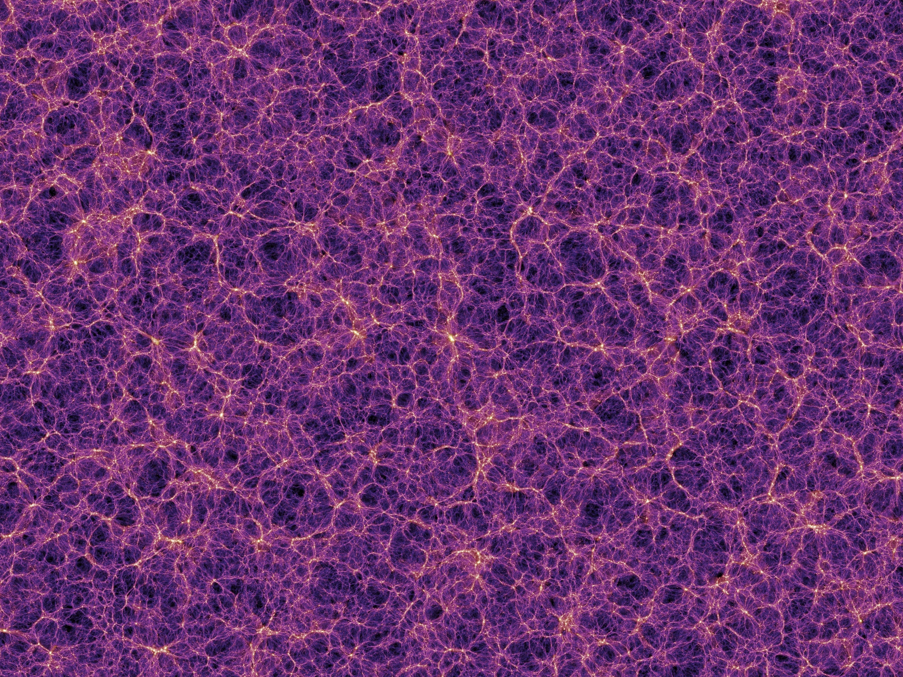
What is Dark Matter?
Evidences for Dark Matter
Huge amount of evidences
indicating that dark matter
exists. One of the biggest
unsolved, but very well measured,
problems in physics.
Observations indicate that DM
interacts mainly gravitationally.
So far, we have no
(non-contradictory) observations
that DM was detected by any
non-gravitational mechanism.

Slide 9
Candidates
Neutralinos (higgsino, binos, winos, singlinos)
Axinos
Gravitinos
Sneutrinos
Axions
Sterile neutrinos
4th generation neutrinos
Kaluza-Klein photons
Kaluza-Klein gravitons
Brane world dark matter/D-matter
Little higgs dark matter
Light scalars
Superheavy states (ie. “WIMPzillas”)
Self-interacting dark matter
Super-WIMPs
Asymmetric dark matter
Q-balls (and other topological states)
CHAMPs (charged massive particles)
Cryptons, …
Supersymetric

Slide 10











































The Flatness problem and a Dark Sector
Friedmann Equation:

Slide 11




































The Flatness problem and a Dark Sector

Slide 12



























The Flatness problem and a Dark Sector

Slide 13
The Flatness problem and a Dark Sector
Therefore, k=0 (critical density) is highly unstable!!!
Critical density near 1 now means near 1 around nucleosynthesis with 20 digits certainty!!!
Thus better we have critical density as a result of inflation.
All contributions should add up to the critical density!
Dark Matter + Visible Matter (Baryons) +
[something else](Dark Energy) = critical mass!

Slide 14
The Dark Energy Question
Type 1A Supernovae are the result of a binary system
One of them is a subcritical White dwarf that acretes from its companion.
Upon accretion, it becomes critical and ignites
Its mas and constitution are know
Thus they are standard candles
Have (and are) been used to caracterize the Hubble relation

Slide 15
The Dark Energy Question
Type 1A Supernovae observation and use of Hubble relation imply that the Universe is in accelerated expansion!!!
A model for the expansion is a cosmological constant, positive, equivalent to a mass density of the order of 69% of the critical mass
Together with previous figures, the Universe is flat.
This constitutes the ΛCDM Standard Model, or Concordance model of Cosmology

Slide 16
The Cosmological Question
The ΛCDM Standard Model is flat, contains Dark Matter (27%), 4% Baryonic Matter (including “minorities”). And today´s data are almost well described
Nothing can describe the Cosmological constant, whose size, compared to Elementary Particle Standard Model is 120 times smaller. Weinberg pointed that out long ago and it constitutes the Cosmological Constant problem

Slide 17
The Cosmological Question
Moreover, Dark Matter and Dark Energy are of the same order of magnitude today, although DE is constant and DM decays with the cube of the scale fator.
This is known as the coincidence problem
Together with the fact that as for today the Dark Sector does not communicate (except for gravity) with the visible Sector, we are in a position of total lack of knowledge about circa 95% of the matter contente of the Universe

Slide 18
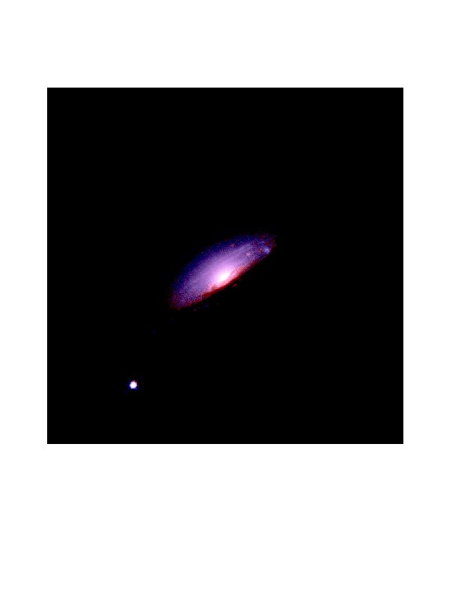
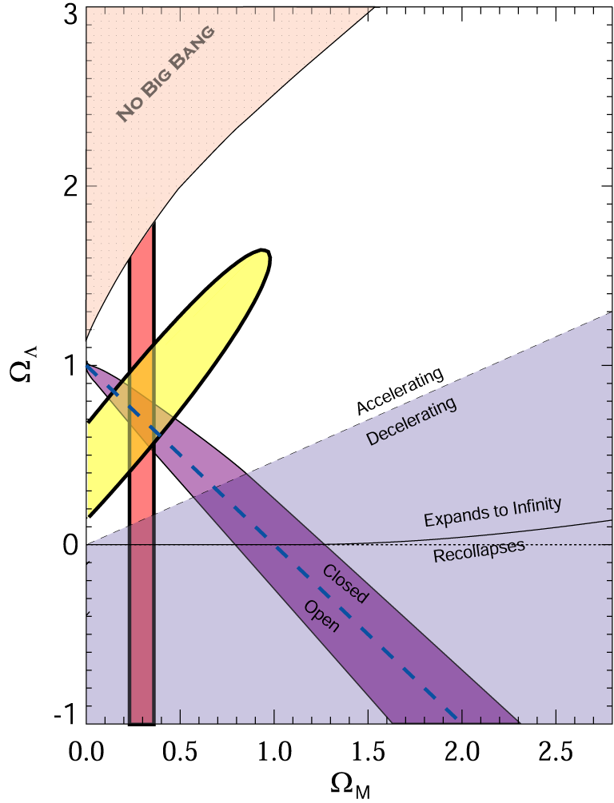
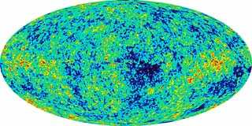
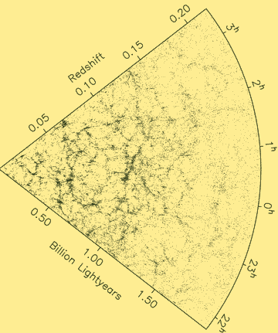
What is Dark Energy?
The Evidence:
98's: The universe is expanding in an accelerated way.
CMB
SNe Ia
Ω_{DE}=0.721±0.025 (WMAP)
WMAP
LSS
Ω_{DE}=0.685±0.013 (Planck)
Source: S. Tsujikawa, “Dark Energy and Modified Gravity"

Slide 19
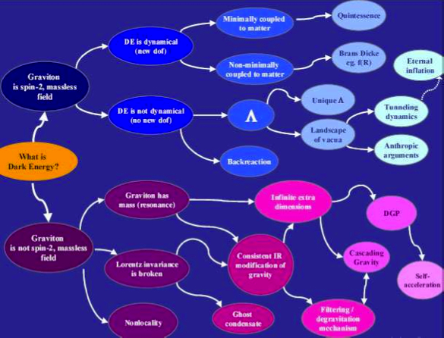
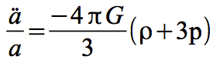
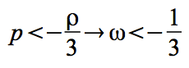
What is causing the acceleration?
Source: de Rahm & Tolley, 2008

Slide 20
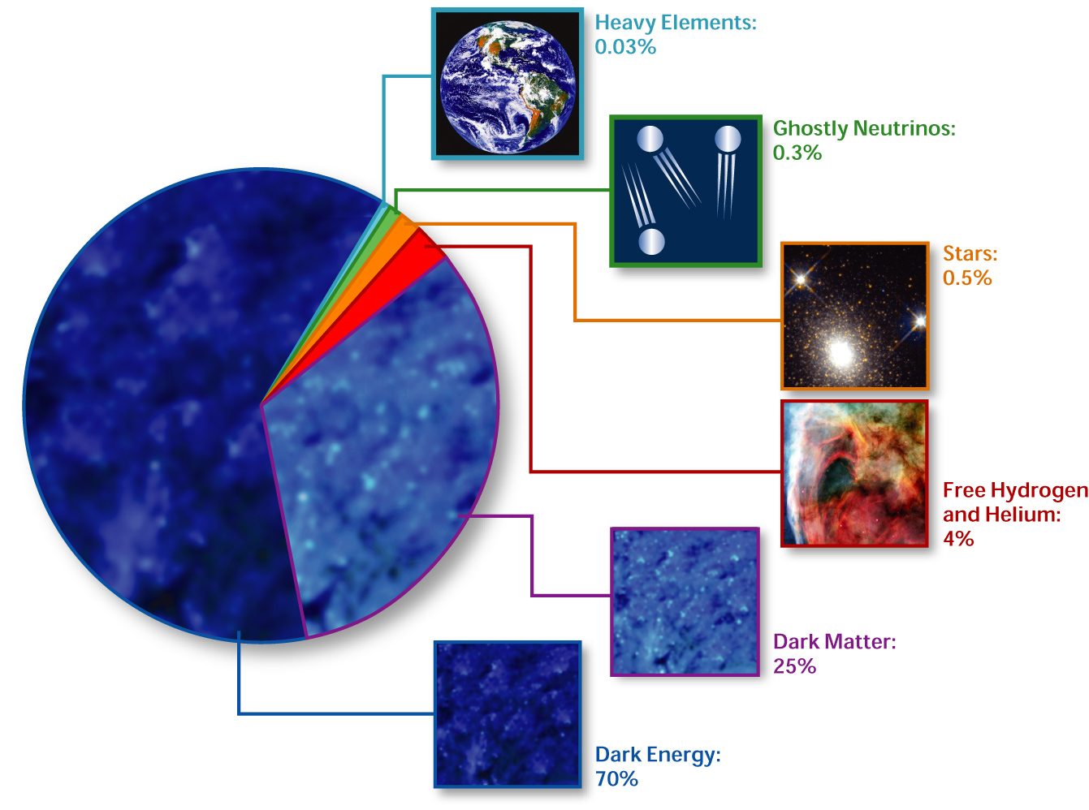
Standard Cosmological Model Composition of the Universe
Elcio Abdalla-Interacting Dark Energy
http://en.wikipedia.org/wiki/Image:Cosmological_composition.jpg source and rights]

Slide 21
The Dark Sector Structure
There is no established model for the Dark Sector based on Field Theory
Dark Matter, up to now, is seen as inert matter, na inert transparente liquid oblivious to touch (no electromagnetism)
Dark Energy is just a cosmological constant.

Slide 22
The Dark Sector Structure
Possibilities already considered
1. DM as a fluid with zero pressure
2. DE as a fluid with pressure equal to minus the density (Cosmo Const)
3. DE as a fluid with negative pressure. Equation of state
p=-ꙍρ, where ꙍ is also called equation of state parameter. For 1/3< ꙍ<1 the gravitational solution is in accelerating expansion

Slide 23


























Precision Cosmology
The way to establish facts is via Precision Cosmology.

Slide 24
Precision Cosmology
That is, Einstein Equation is perturbed, we also use Boltzmann Equation to describe the perturbed fluids in interaction and the perturbed field equations. All become linear and can be solved by sophisticated numerical methods.
We compute correlators in the sky also called
1. power spectrum (two point correlators
2. Bispectrum (three point correlators)
3. We obtain temperature variations in the sky

Slide 25
Precision Cosmology
Observing Sky Radiation we have results with high precision, the
Precision Cosmology

Slide 26
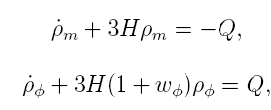
DE/DM Interaction
Each component is not conserved alone anymore.
Cosmological equations:
Many many models in the literature:
Phenomenological (For a classiﬁcation see Koyama, Maartens, Song, 0907.2126; see also Wang, Abdalla, Atrio Barandela, Pavon Rep. Prog. Phys. 2016)
- Interaction depending on DM or DE
Constant coupling
or
Time varying coupling
Coupling must be small : constraints from observations!
In general no analytic solution!

Slide 27
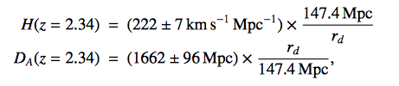
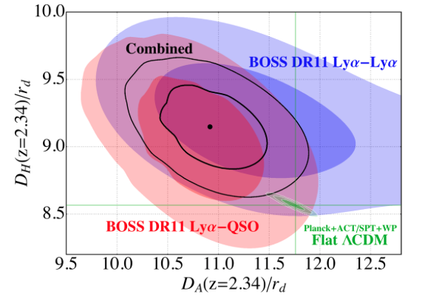
Evidence Against ΛDCM?
Baryon Acoustic Oscillations in the Lyα forest of BOSS DR11 quasars.
T. Delubac et al. [BOSS Collaboration] – A&A 574, A59 (2015), arXiv: 1404.1801
From adjusting the BAO peaks and combining with the ΛCDM fiducial values from Planck+ WMAP:
Values differ: 1.8σ from Planck+WP;
1.6σ from WMAP9+ACT+SPT
Constraints on (D_{A}/r_{d},D_{H}(=H/c)/r_{d})
Conclusion: Approximately 2σ below the value of D_{H}
And 2σ above the value of D_{A}
compared to the ΛCDM prediction.

Slide 28
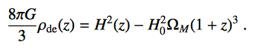
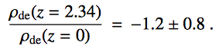
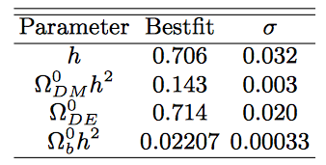
Evidence Against ΛDCM?
Baryon Acoustic Oscillations in the Lyα forest of BOSS DR11 quasars.
T. Delubac et al. [BOSS Collaboration] – A&A 574, A59 (2015), arXiv: 1404.1801
-
~2.5σ difference from the expected from ΛDCM!
Parameters from Planck+WMAP for ΛDCM
Interacting dark energy?
Review Rep. Progr. Phys.: Wang, E.A., Atrio-Barandela, Pavon

Slide 29
Whispers of the Universe: the BINGO project
The ABDUS Project

Slide 30
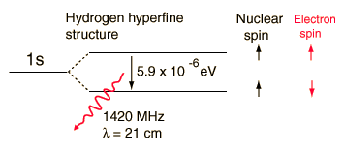
21 cm Physics – The Hyperfine Structure

Slide 31
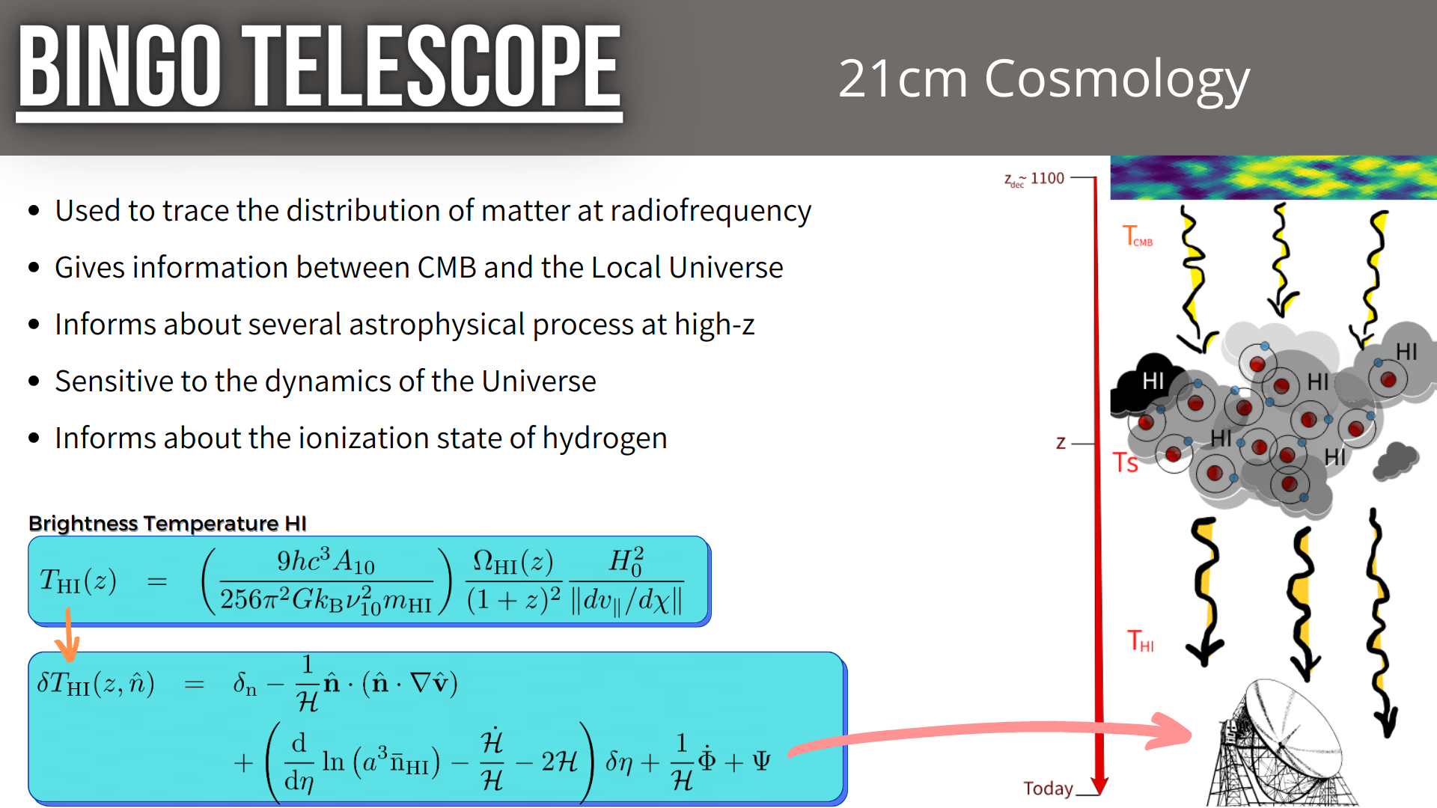
21 cm Cosmology: Motivation and Methods

Slide 32
Intensity Mapping
No Search for particular emission
Search instead for general Hydrogen emission
Large clouds

Slide 33
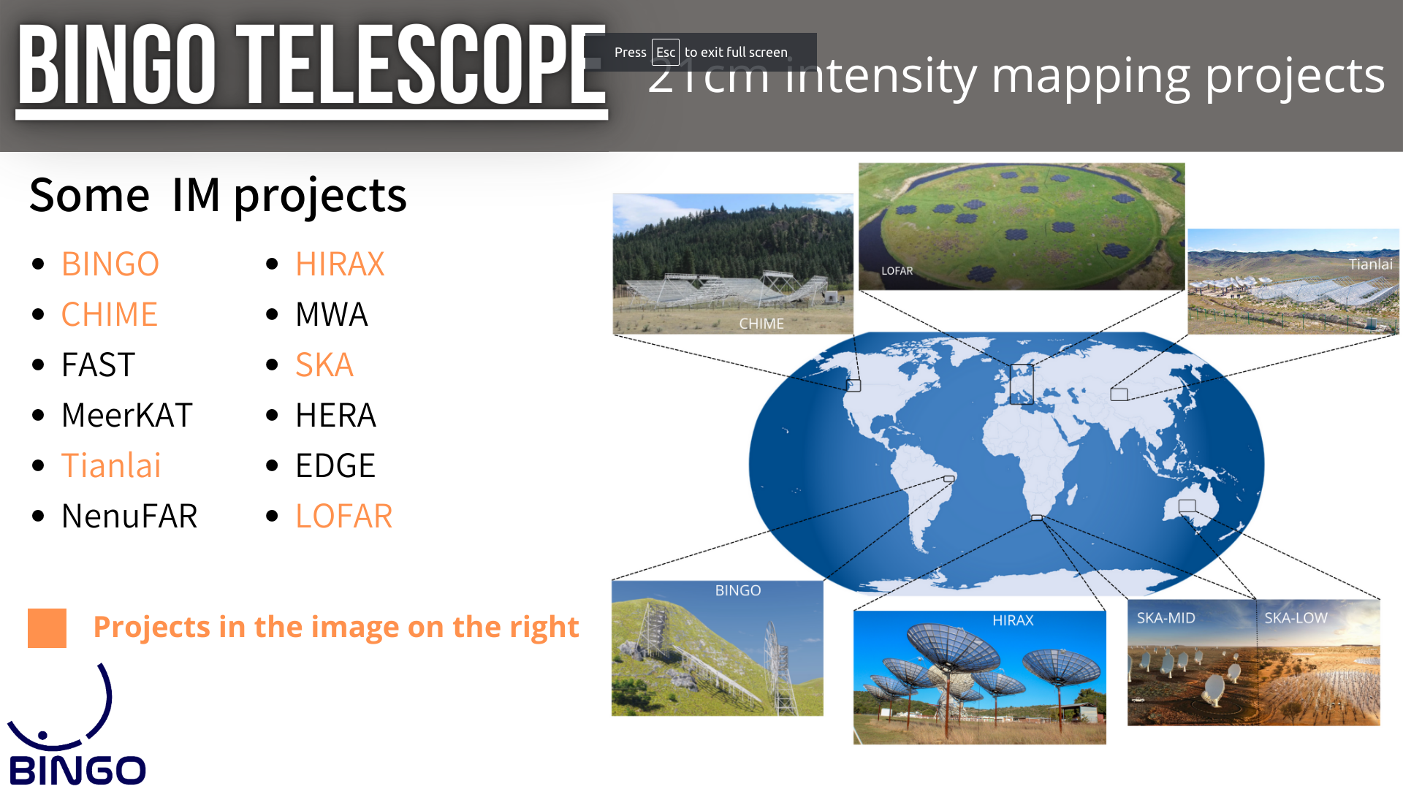

Slide 34
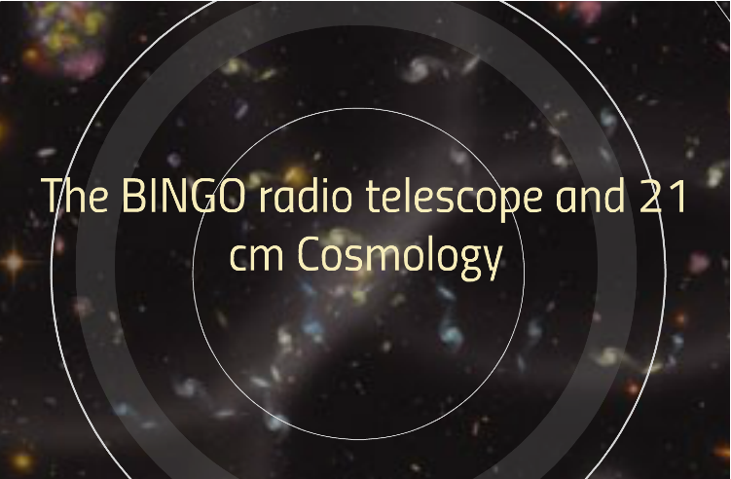

Slide 35
Bingo´s aims
BAO for Integrated Neutral Gas Observations
Large scale structure and constraints on Cosmological parameters (particularly DE)
HI intensity map at 0.127 < z < 0.448
Astrophysical phenomena: Fast Radio Bursts and Pulsars

Slide 36
What is Bingo?
BAO for Integrated Neutral Gas Observations
A single/double dish multiple Horns Radio Telescope, mainly to measure BAO
Short scale phenomena (we can pinpoint short lumps)

Slide 37
The Instrument
Two dishes (40 and 39 meters)
28 Horns (1.8 m wide, 4.8 m long)
System Temperature 50 K (up to now, we have 70K)
Simple off the shelf electronics in phase 1
Phased arrays in bingo 2
Site at “Serra do Urubu” (Vulture heights) in Paraíba, Brazil

Slide 38
The Site

Slide 39
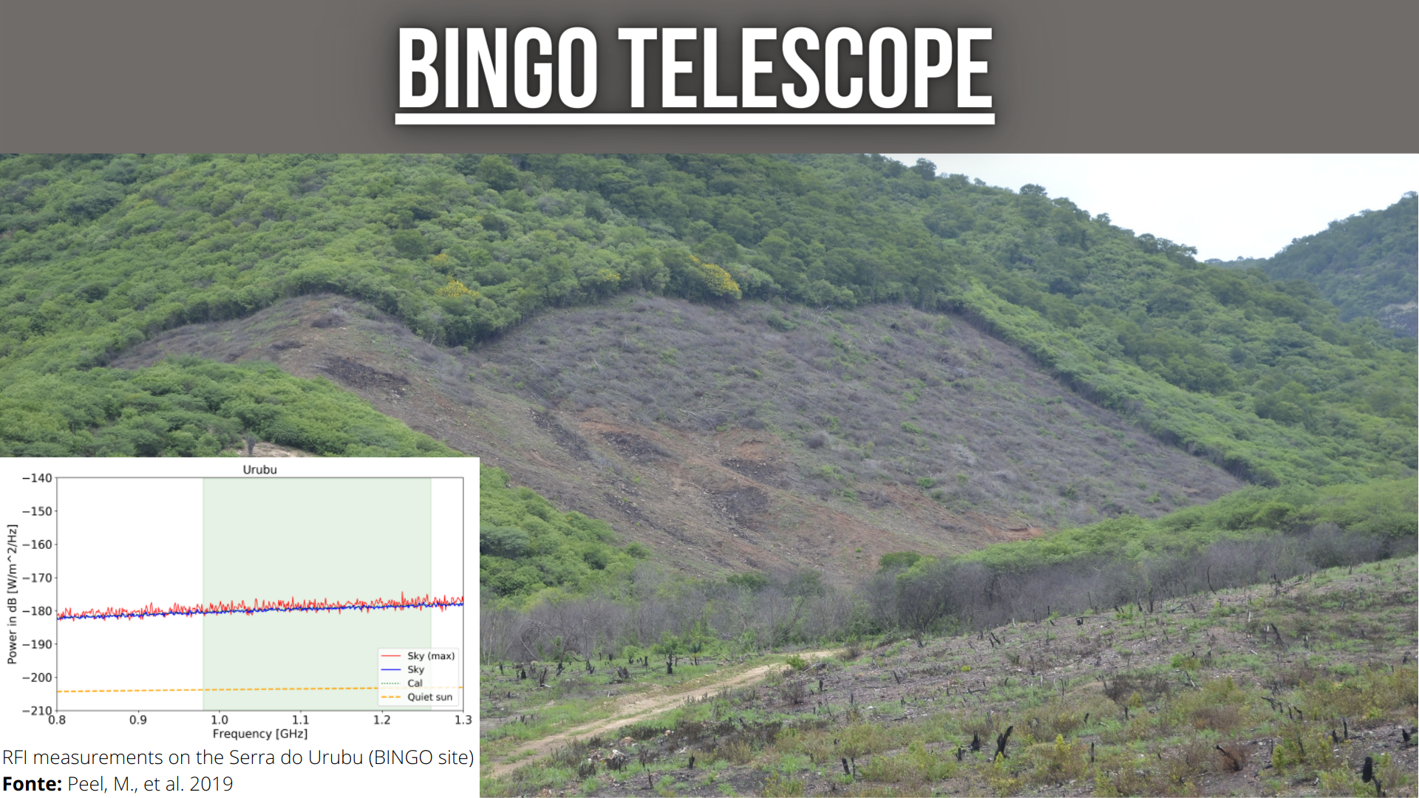
The Site
Clean sites in South America

Slide 40
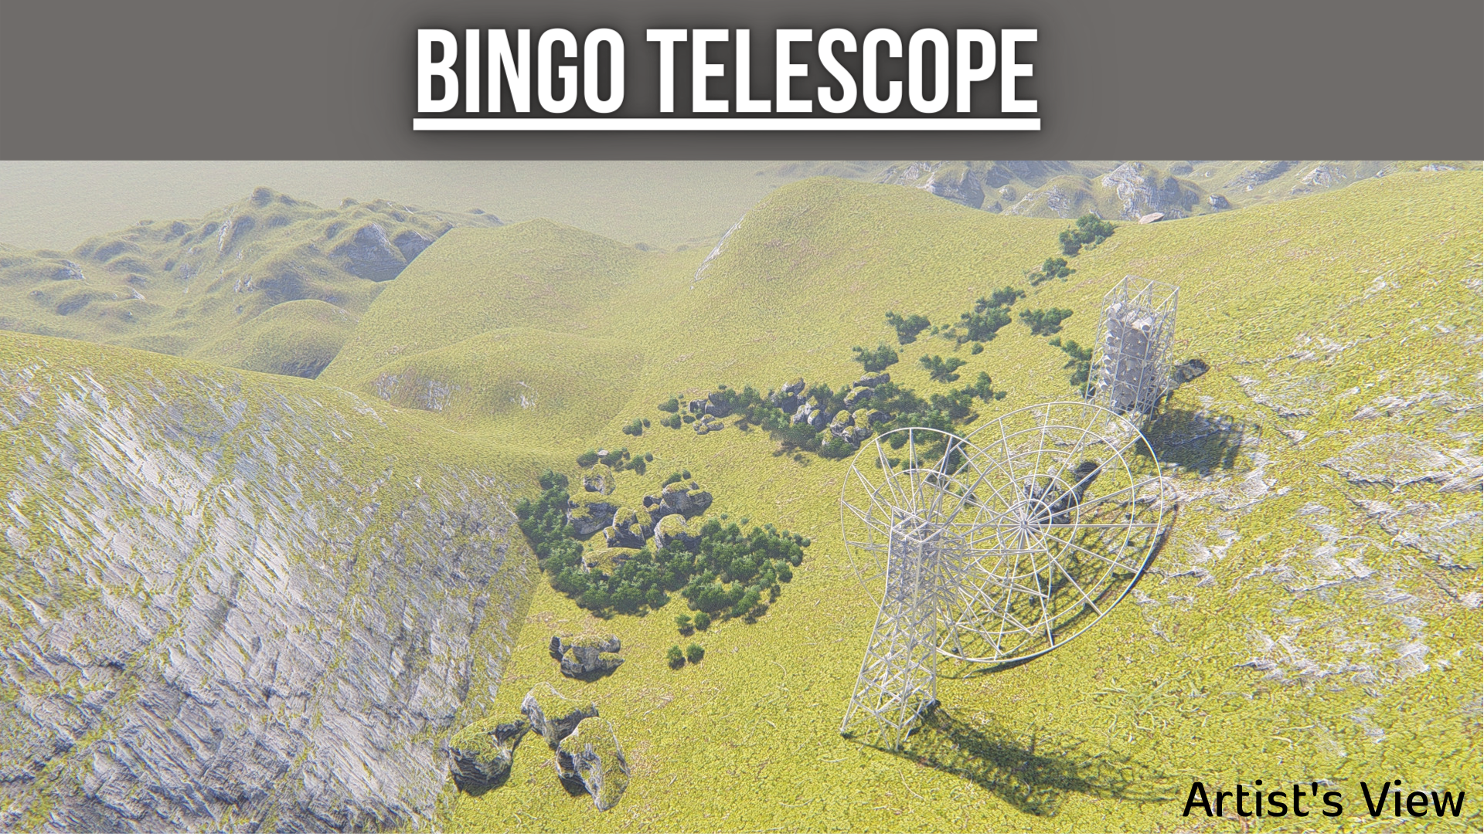

Slide 41
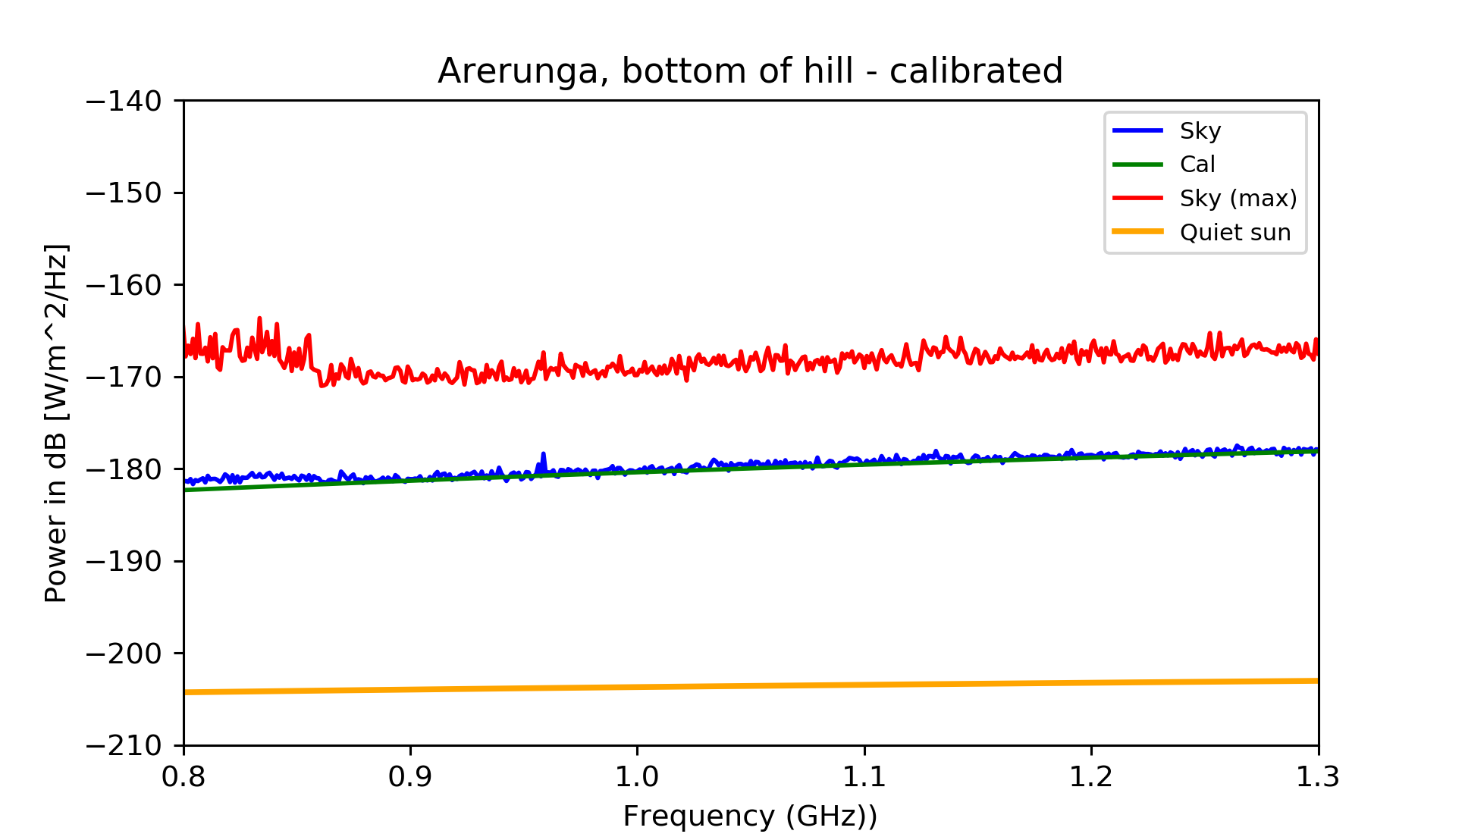
Uruguay

Slide 42
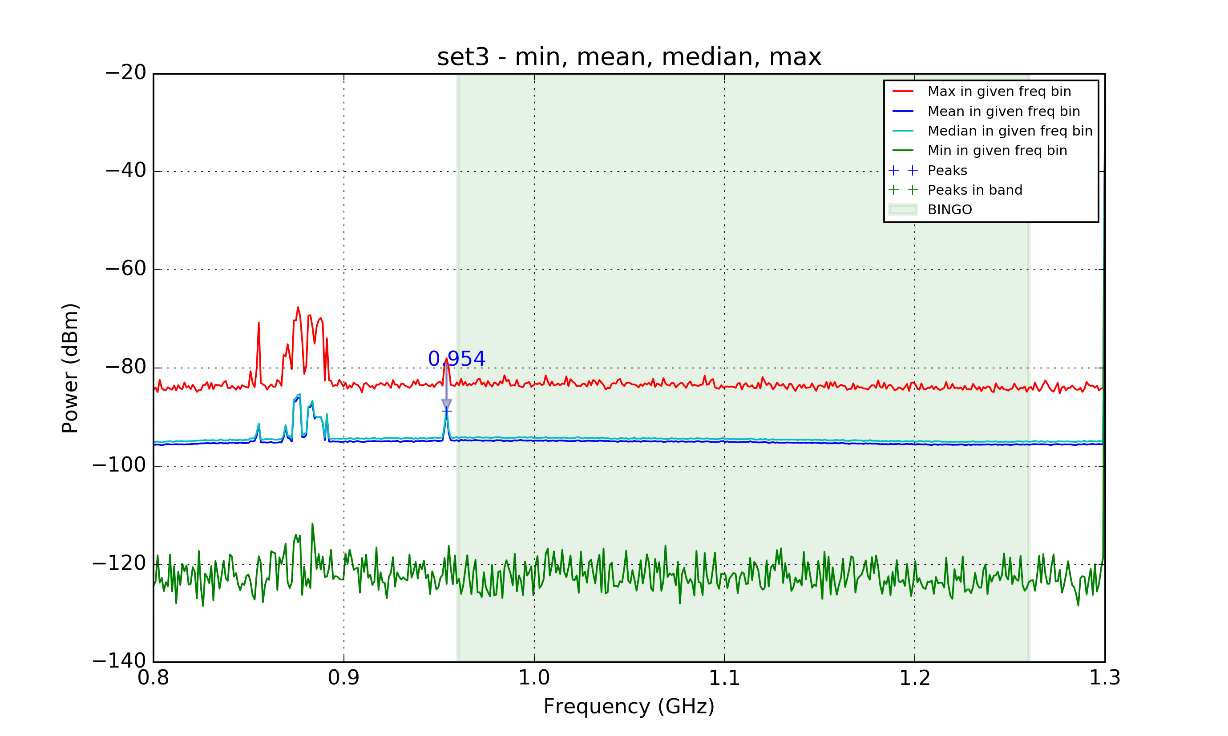
Cachoeira Paulista (SP)

Slide 43
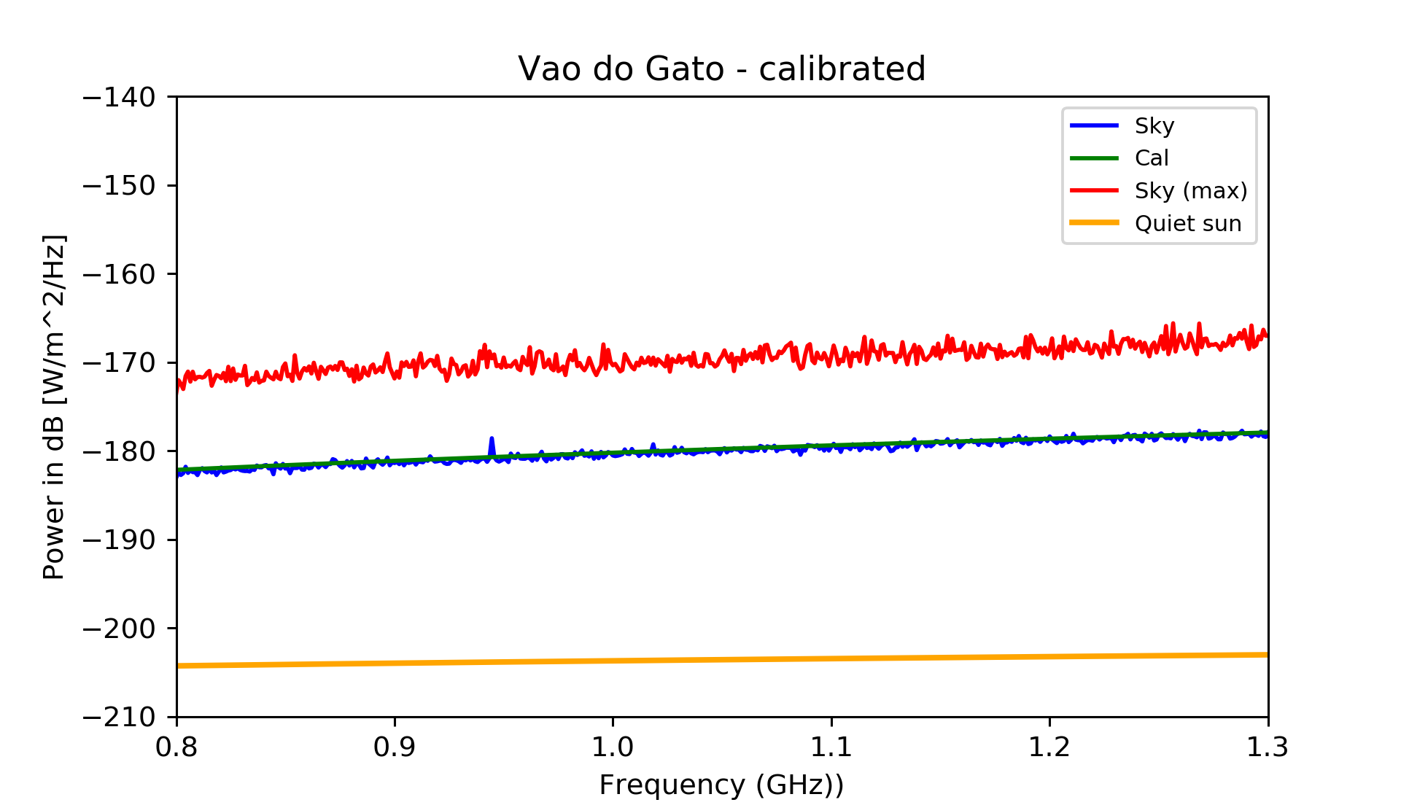
Vão do Gato (Cat’s den) Paraíba

Slide 44
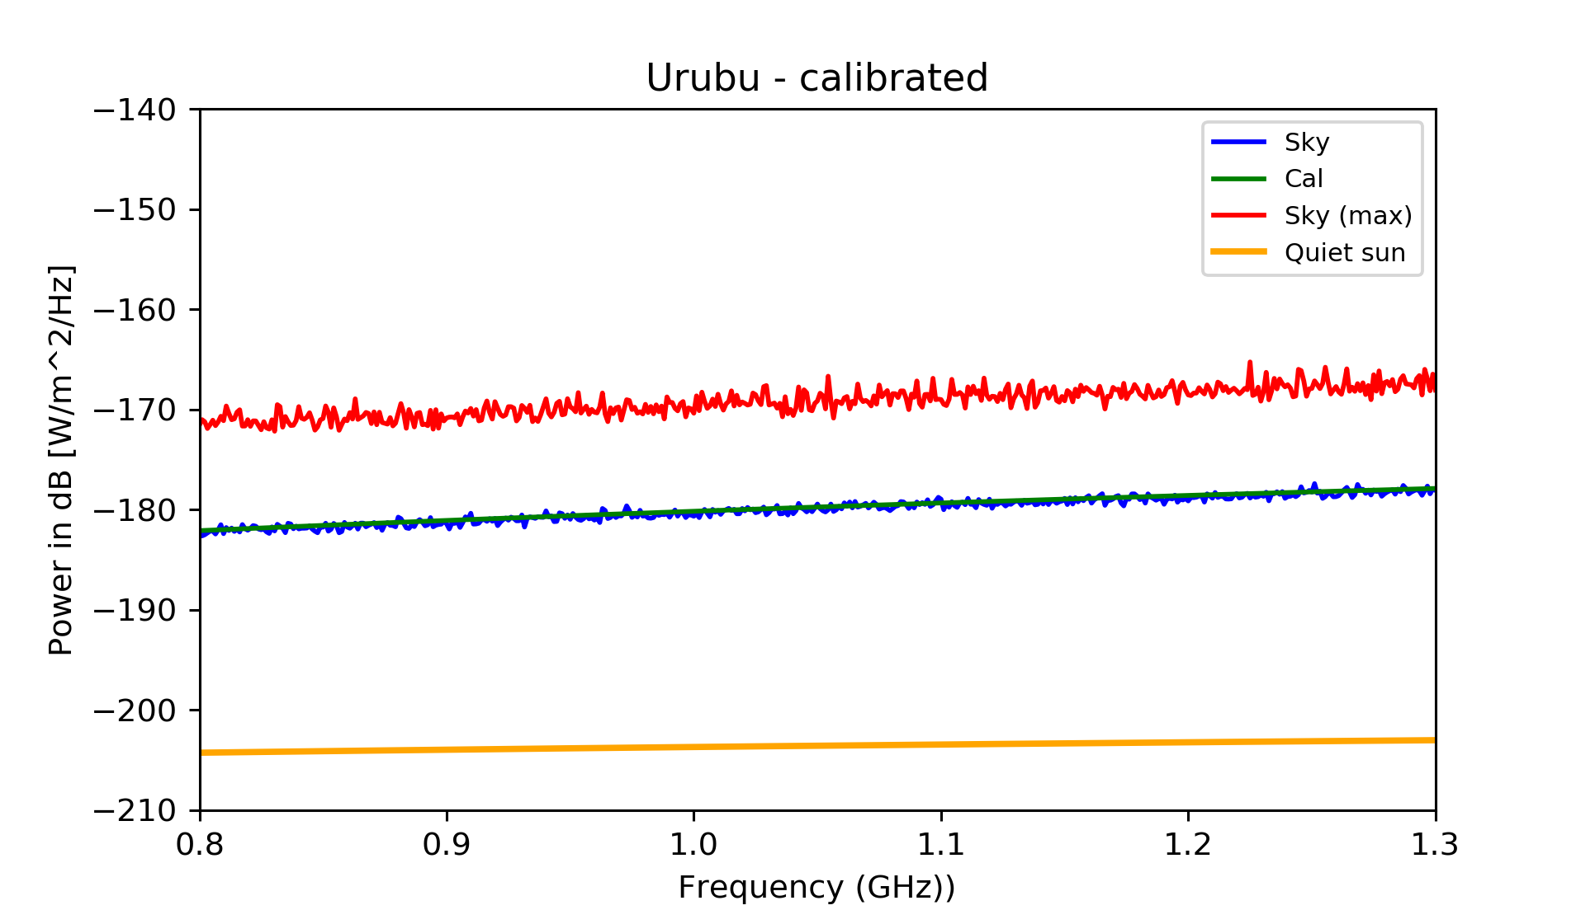
Urubu (Vulture heights), Paraíba

Slide 45
Motivations for BINGO
HI intensity mapping to measure BAO
Structure formation
Dark Sector properties (last half history of the Universe)
Static telescope, excellent for looking after transient phenomena
Fast astrophysical phenomena:
Pulsar properties
Fast Radio Bursts

Slide 46
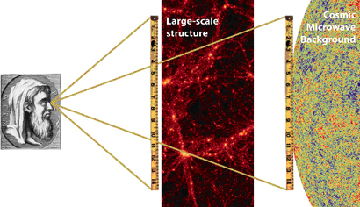
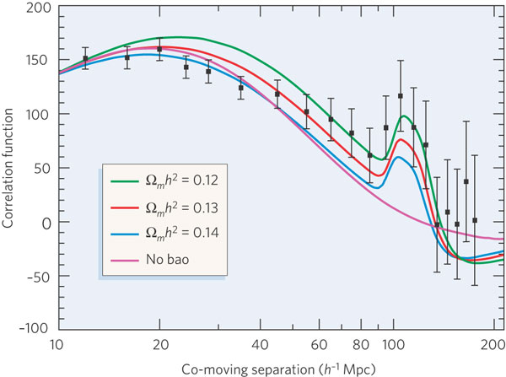
Baryon Acoustic Oscillations (BAOs)
Baryon oscillations seen in the CMB distribution can be observed in the spatial distribution of galaxies
Credit: EUCLID website (ESA)
The acoustic peak gives the ratio of the distances to z=.35 and z=1,100 to 4% fractional accuracy.
absolute distance to z=0.35 is determined to 5% accuracy.
co-moving sound horizon scale 150 h⁻¹ Mpc.
Credit: Bennett, Nature (2006)

Slide 47
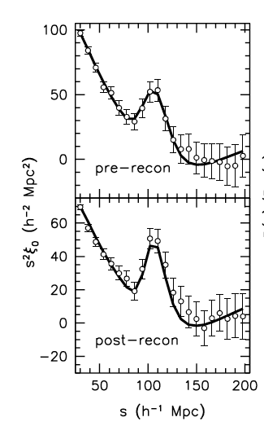
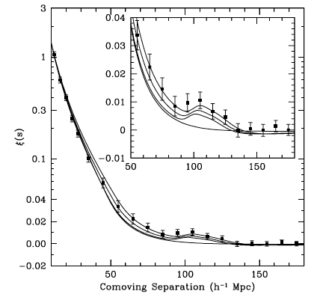
Optical BAOs
Anderson et al. (2014)
Eisenstein et al. (2005)
C.A. Wuensche (2016)
Notes:
The statistical sensitivity of the BAO measurement is limited by non-linear structure formation. Following Eisenstein et al. (2007a) we apply a procedure to reconstruct the linear density field. This procedure attempts to partially reverse the effects of non-linear growth of structure and large-scale peculiar velocities from the data. This is accomplished using the measured galaxy density field and Lagrangian theory relations between density and displacement. Reconstruction reduces the anisotropy in the clustering, reverses the smoothing of the BAO feature due to second-order effects, and significantly reduces the expected bias in the BAO distance scale that arises from these same second-order effects. Reconstruction thus improves the precision of our BAO scale measurements while simplifying our analyses.

Slide 48
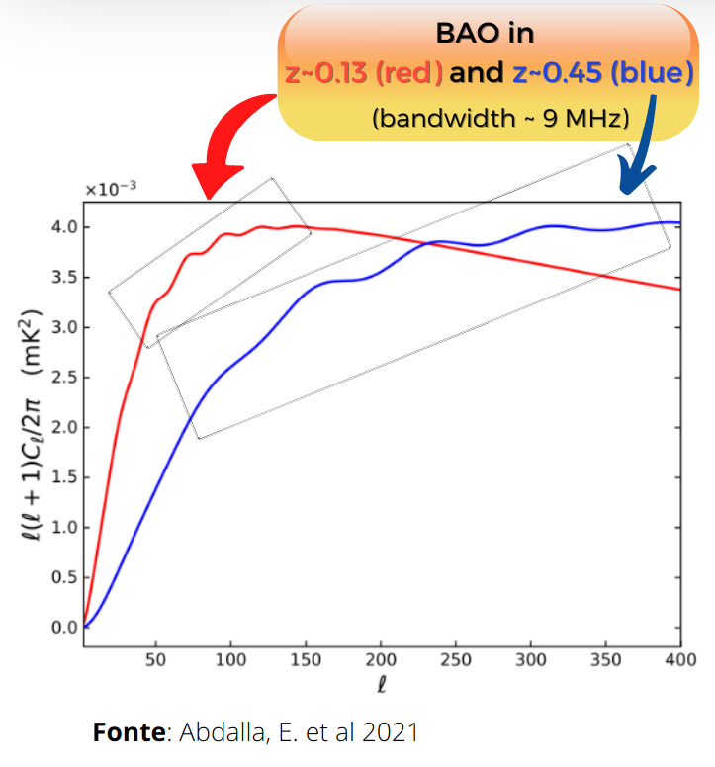
Baryon Acoustic Oscillations (BAOs)
Acoustic waves imprinted on CMB 380,000 years after Big Bang
Acoustic scale set by distance light travelled at that time
Known precisely from CMB power spectrum
D=149 ± 0.6 Mpc
BAO scale imprinted on all matter in the Universe
Use as a “standard ruler”
Credit: Chris Blake

Slide 49
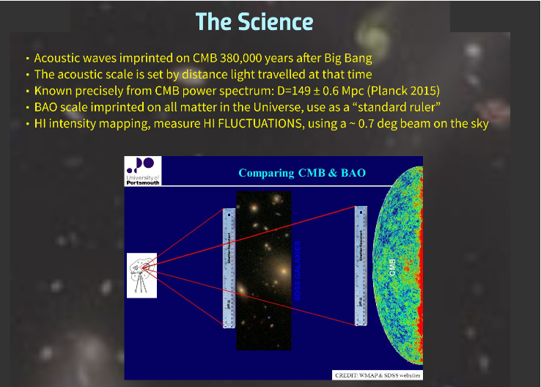

Slide 50
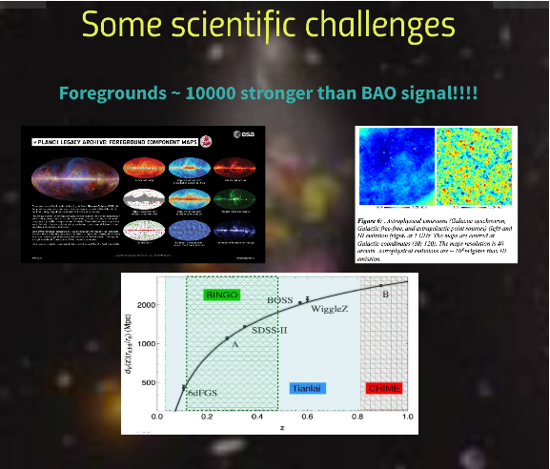

Slide 51
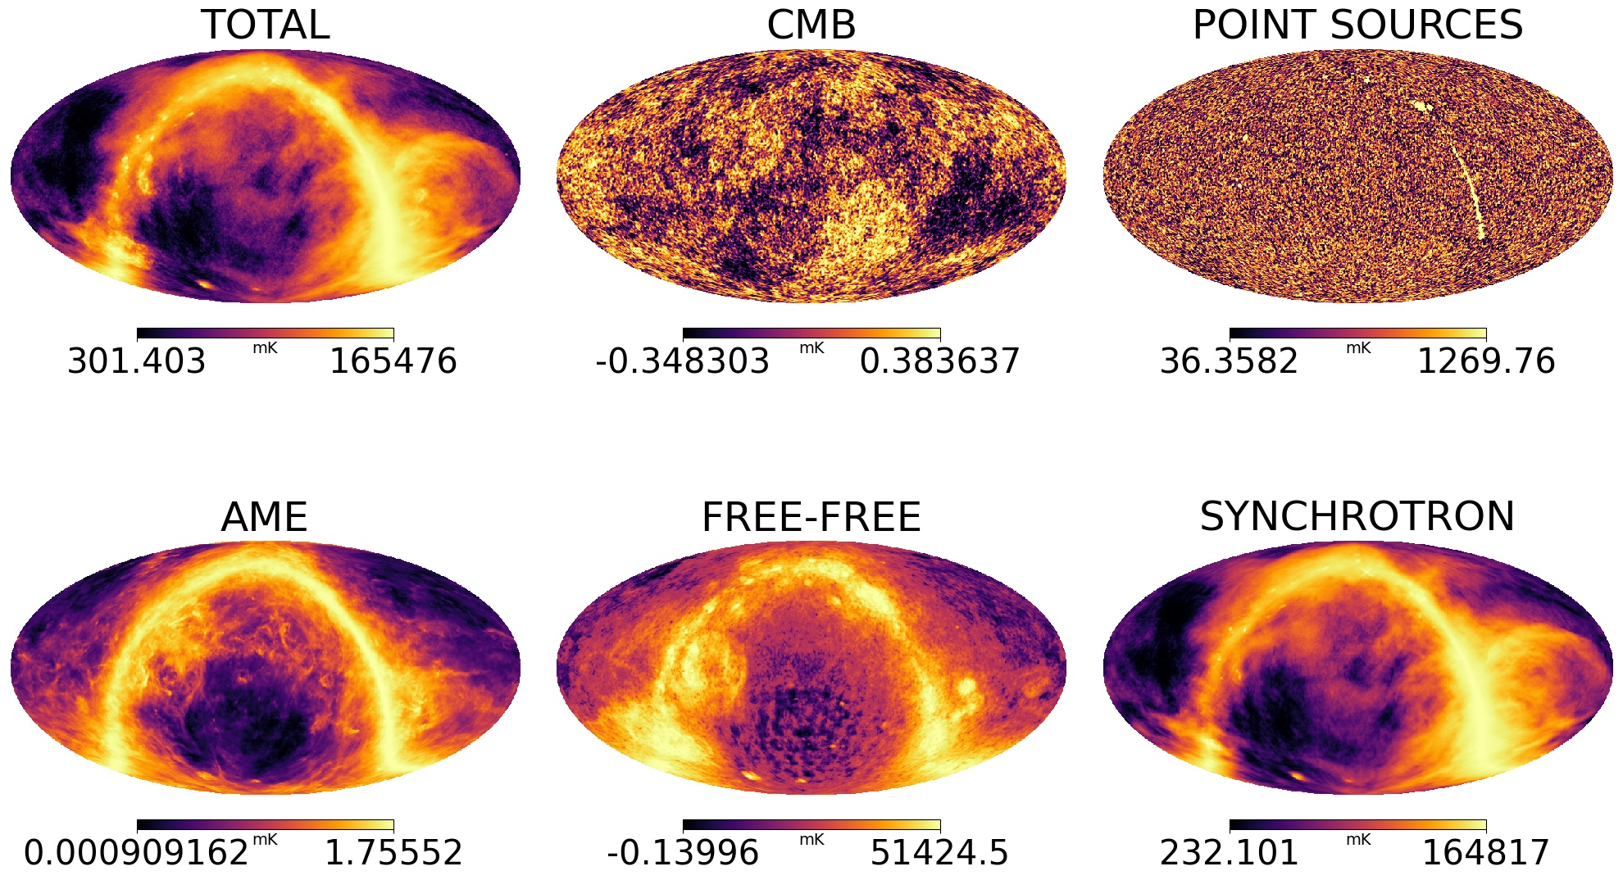

Slide 52
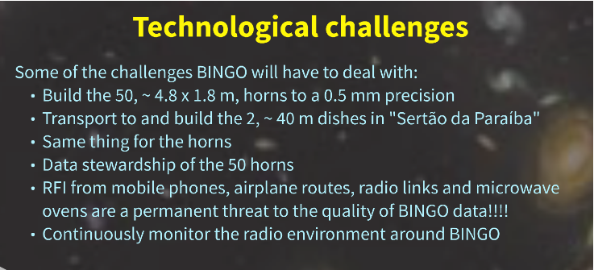

Slide 53
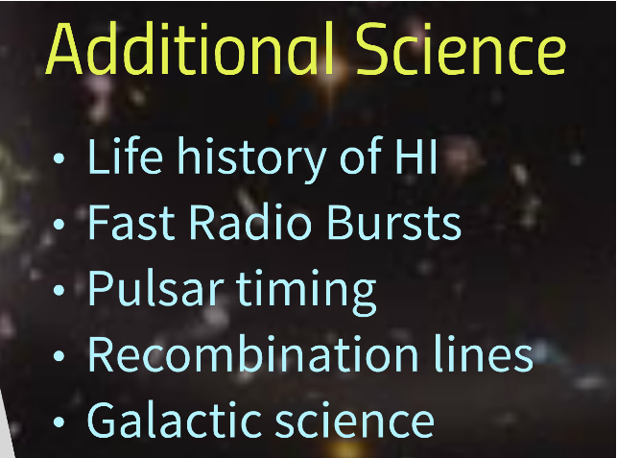

Slide 54
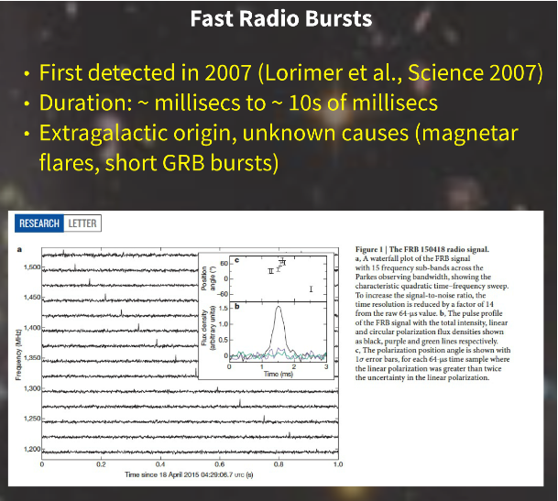

Slide 55
The various stages

Slide 56
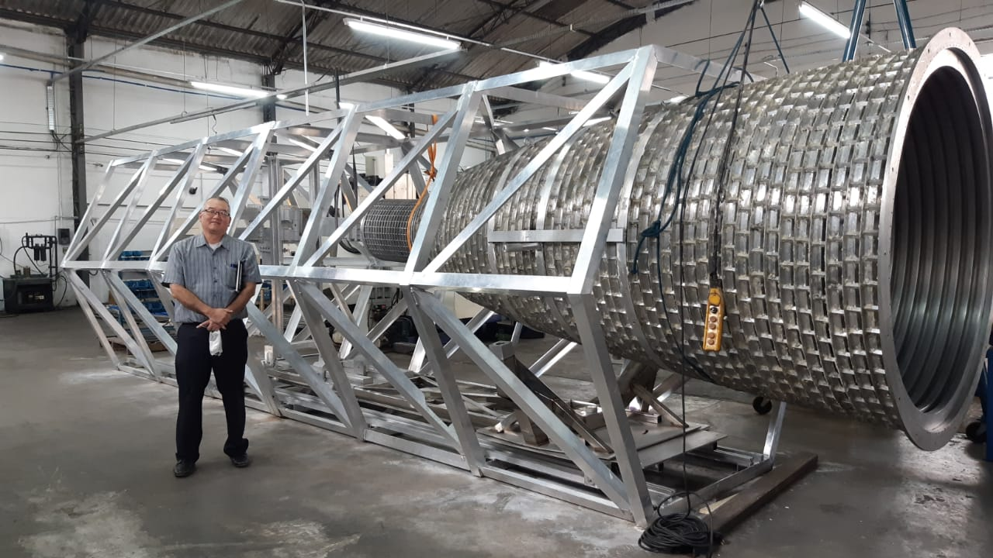
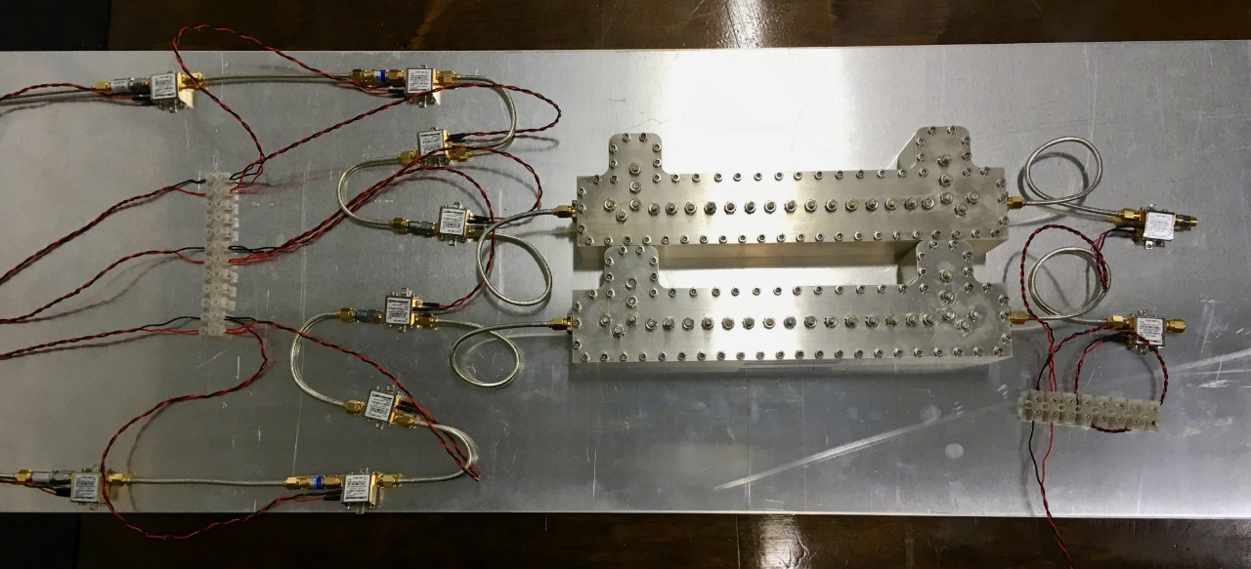
Stage 0
The Instrument:
Horns (basically done)
Receiver (already projected, now in series)

Slide 57
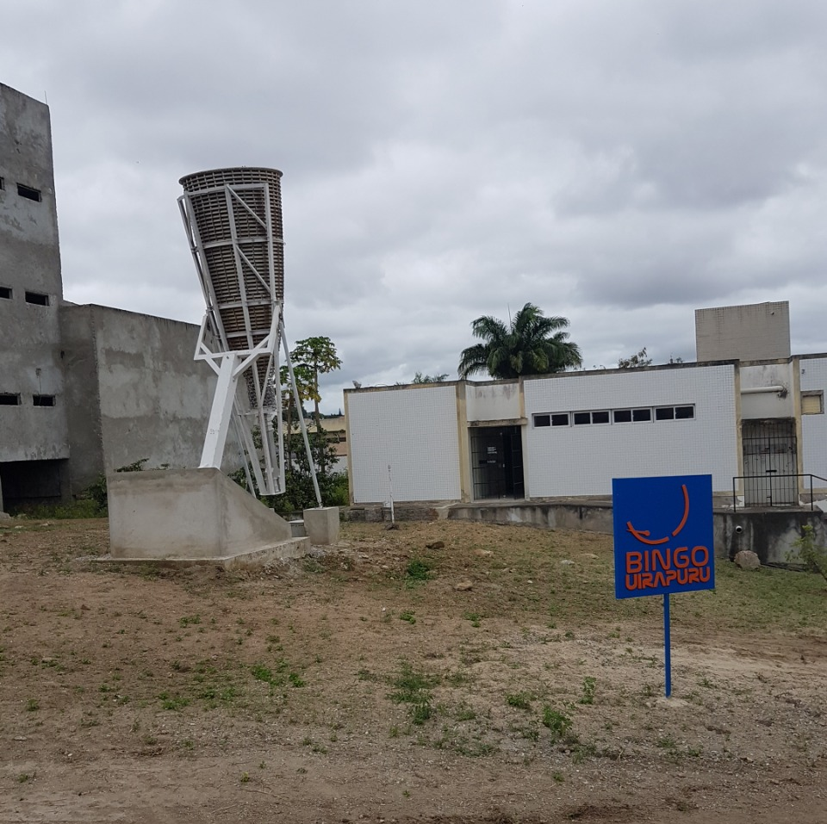
Stage 1
Raw data
FRB´s
Outriggers (Uiapuru in Campina Grande University campus, Paraiba)

Slide 58
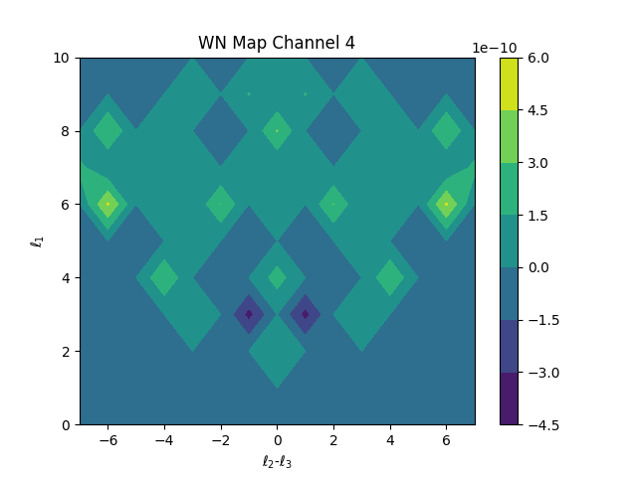
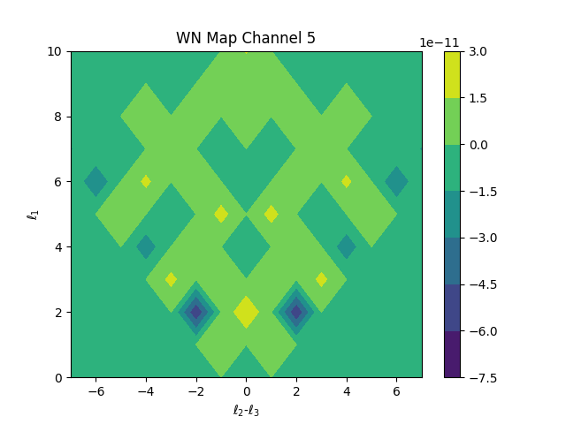
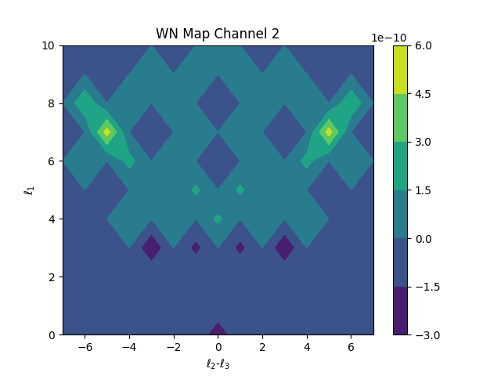
Stage 2
Component Separation
Noise analysis
Bispectrum

Slide 59
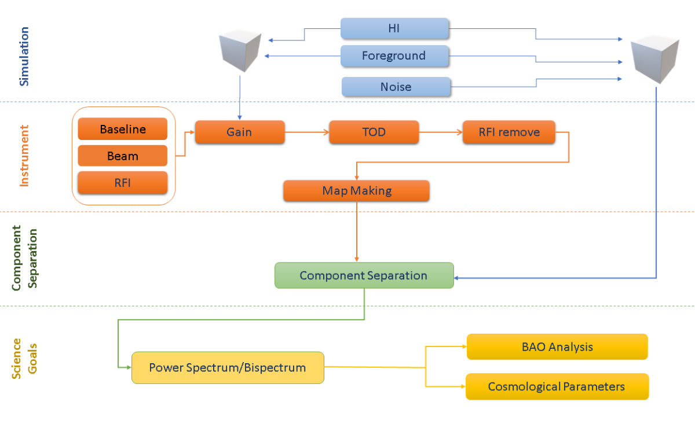
Stage 2
Component Separation: power spectrum, BAO, Cosmological Parameters

Slide 60
Stage 3
Mocks

Slide 61
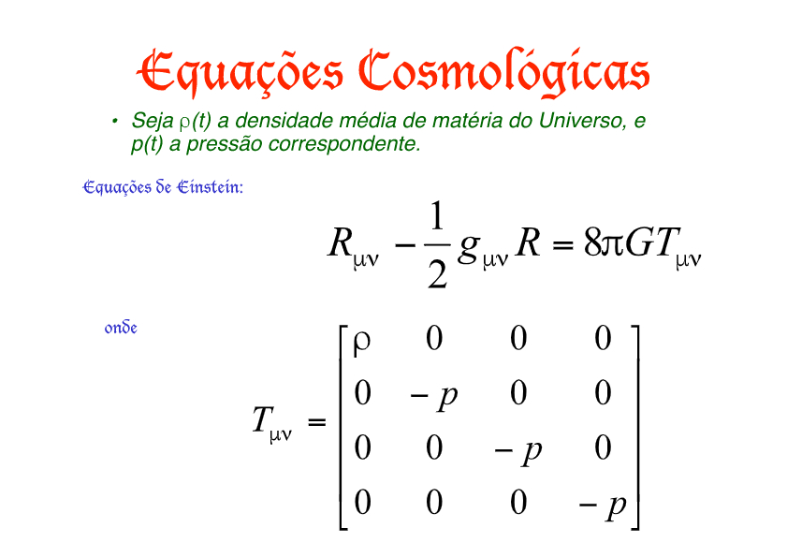
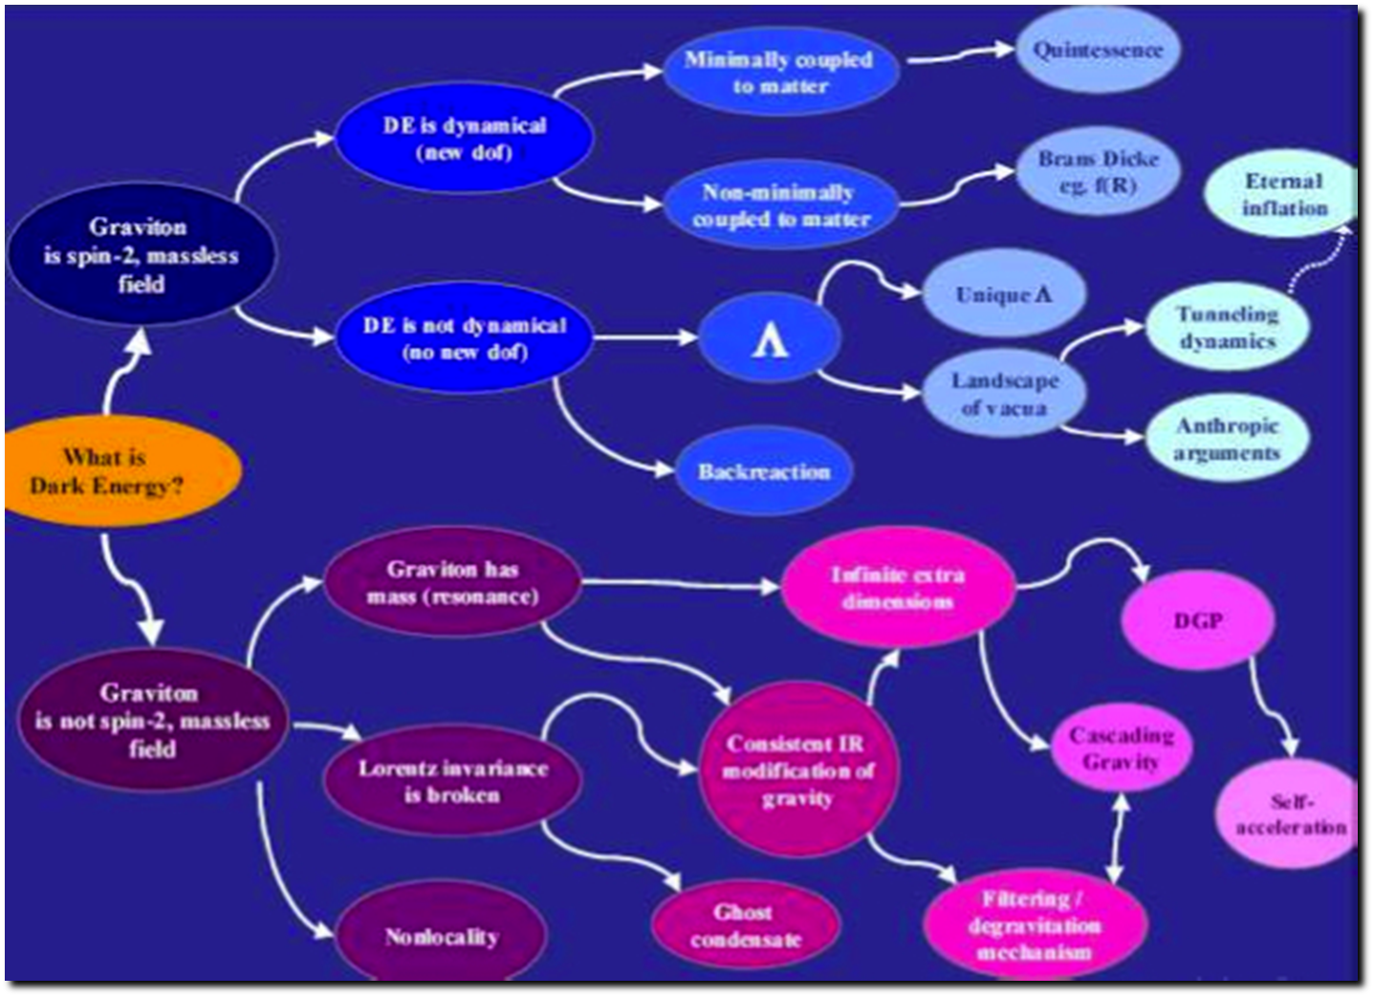
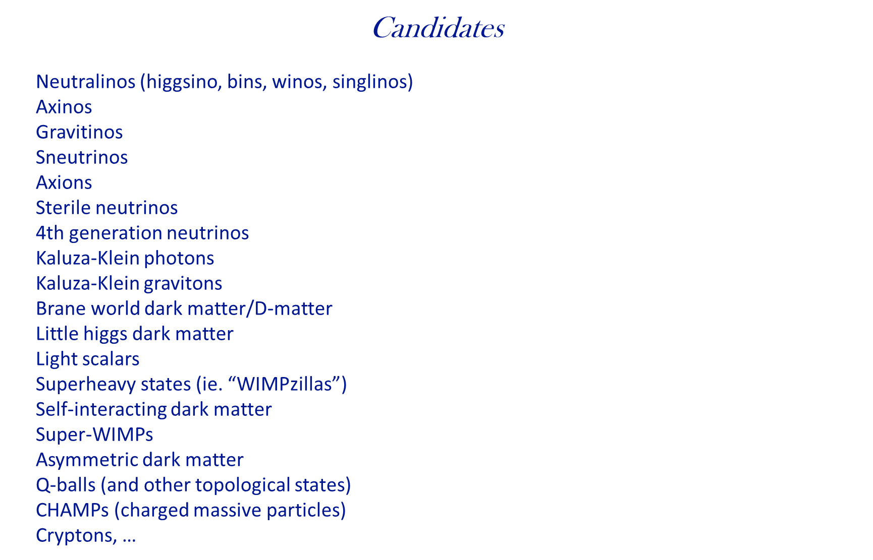
Stage 4
Theory

Slide 62
Theory
Structure of Dark Sector
cosmological parameters
DE/DM interactions
Models of DM/DE
FRB´s and cosmological parameters/consequences
Mass distribution
Pulsars
Flaring stars
Astrophysical signs and consequences
..............................

Slide 63




Construction
Ongoing construction operations

Slide 64



Outreach and education

Slide 65

Outreach and education
Work with local population and support from local Secretary of education from the Paraiba State

Slide 66







BINGO High Resolution the abdus project
Filipe Abdalla, Amilcar Queiroz, Elcio Abdalla, Bin Wang
450 – 1450 MHz
(z ~ 0 – 2.1)
1 MHz resolution
1.2 deg Resolution
T system 40K
Station 4500 m²
- What is the nature of dark energy?
- Can we measure the fluctuations with 21cm radiation
- Is our model of cosmology correct?

Slide 67

abdus forecasts
Can be competitive with even the largest surveys such as the Square Kilometre array.
Can also do other ancillary science extremely well such as finding the elusive FRBs.

Slide 68



Searching for FRBs with BINGO.
The FRB will have an intrinsic flux, which is modelled by our mock catalogue given observed data (Luo et al 2020.)
The noise is obtained given telescope and outrigger characteristics.
A mock catalogue is created for the entire sky.
Effective maximum redshift
S/N

Slide 69


Search for FRBs with BINGO main
Several FRBs will be found, competitive with CHIMES, but no localization is possible with the main telescope only.

Slide 70


Using outriggers to locate the FRBs

Slide 71



Cross Correlations
Several stations, signal to noise given by:
We aim to have three stations at different locations, to be able to cross correlate them.

Slide 72
ABDUS and phased array antennas
Phased arrays consist of closely distributed antenna elements, allowing synthesis of multiple independent beams.
ABDUS proposes the use of phased arrays to boost BINGO's capabilities.
ABDUS-1 involves associating phased arrays with the BINGO focal plane using Vivaldi antennas and beamformers.
ABDUS-2 includes outriggers composed of feed horns and phased-array stations 20 km away to achieve higher angular resolution.

Slide 73



Unit Cell simulation
One unit cell is assumed with four antenna elements, two for each polarization.
We excite two elements of same polarization and run EM simulations on HFSS sofware.

Slide 74



Vivaldi Tile simulation
We simulated a 2x8 array. It correspond to a 35cm x 134 cm tile that will be used on ABDUS project.
The tile is also under tests on ASTRON facilities and will be sent to Brazil after some measurements be finished.

Slide 75


Vivaldi Tile simulation: scanning
The array can be be electronically steered to point in different directions without moving the antennas.
We then present simulations steering in some different directions.

Slide 76








BINGO
BAOs from Integrated Neutral Gas Observations

Slide 77

Serra do Urubú (PB) – 07 deg 02'57.1"S, 38 deg15'46"W

Slide 78

Localização do BINGO: Coords: 7° 2' 27.6” S; 38° 16' 4.8" W
Paraíba state
8

Slide 79



Slide 80
Support
FAPESP (Fundação de Amparo à Pesquisa do Estado de São Paulo)
Paraiba Government (João Azevedo, Claudio Furtado, Rubens Freire) *
FINEP (Projects and Studies financing – Federal Government)
Ministry of Science and Tecnology (Brazil)
Federal University of Campina Grande
University of São Paulo
National Natural Science Foundation of China
YangZhou University (China)
INPE (National Institute of Space Research, Brazil)

Slide 81




Main Collaborating Companies
Alltec (São Paulo): metallurgy/horns
CETC 54 (China): metal structure
IBRTEL (Paraiba): construction
Ponto de Apoio and GTP (projects)

Slide 82


Slide 83




Main Collaborating Companies
Alltec (São Paulo): metallurgy/horns
CETC 54 (China): metal structure
IBRTEL (Paraiba): construction
Ponto de Apoio and GTP (projects)

Slide 84
Inauguration and begining of commissioning
Between September and November 2024
Thanks for the attention

Slide 85
Visit our sites
https://portal.if.usp.br/bingotelescope/
http://www.bingotelescope.org/en/
https://pt.wikipedia.org/wiki/BINGO_(telescópio)
https://www.facebook.com/BINGOTelescopio/

